Slide 1


Mr Yuri
20-March-2025

Slide 2

Executive Summary Introduction Methodology Results
OUTLINE
Conclusion

Slide 3
Executive Summary
Methodology Summary
Results Summary
Data Collection
Data Wrangling
EDA with Visualization
EDA with SQL
Building an Interactive Map with Folium
Building a Dashboard with Plotly Dash
Predictive Analysis (Classification)
EDA Results
Interactive Analytics
Predictive Analysis

Slide 4
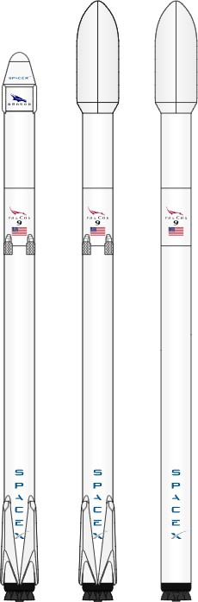
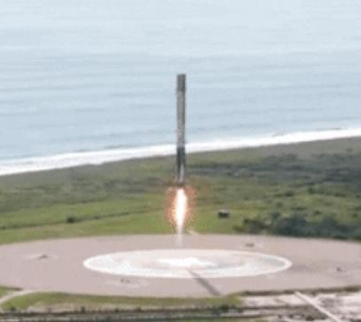
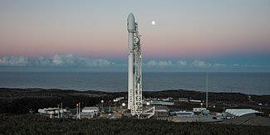
Introduction
Project Background and Context:
SpaceX advertises Falcon 9 rocket launches
on its website, with a cost of 62 million dollars; other providers cost upward of 165 million dollars each. Much of the savings is because unlike other rocket providers, SpaceX’s Falcon 9 can reuse the first stage.
Problem to Solve:
If we can determine if the first stage will land, we can determine the cost of a launch. We will train a machine learning model using the previous data of launches of Falcon 9 rocket to predict if the first stage of the SpaceX will land or not.

Slide 5

Section 1
5

Slide 6
Methodology
Data Collection
SpaceX REST API
Web Scraping from Wikipedia
Data Wrangling
Data cleaning (e.g. replacing missing payload mass with its mean; removing irrelevant columns)
Create a landing outcome label
Data transformation (One Hot Encoding for categorical features, Standardization of numerical features)
Exploratory Data Analysis (EDA) using Visualization and SQL Interactive Visual Analytics using Folium and Plotly Dash Predictive Analysis using Classification Models
Linear Regression, K Nearest Neighbors, Support Vector Machine, and Decision Tree models have been built and evaluated for the best classifier

Slide 7

Data Collection
SpaceX REST API
Web Scraping from Wikipedia
SpaceX launches is gathered from the SpaceX REST API.
The url starts with api.spacexdata.com/v4/
The information gathered include: the rocket used, payload delivered, launch specifications, landing specifications, and landing outcome.
SpaceX lunches is gathered from Wikipedia:
https://en.wikipedia.org/wiki/List_of_Falcon_9_and_Fal
con_Heavy_launches
The launch records are stored in a HTML table
Returns SpaceX data in Json
Convert to a dataframe using Normalize method
Extract data using beautiful soup
Get HTML
Response from Wikipedia
Ready for data consolidation &wrangling
Convert to a dataframe
Use SpaceX
Rest API

Slide 8

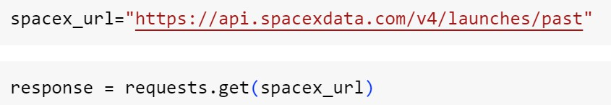
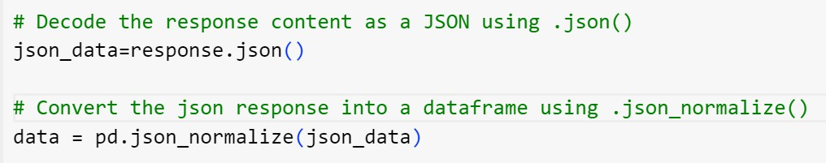

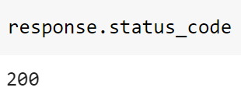

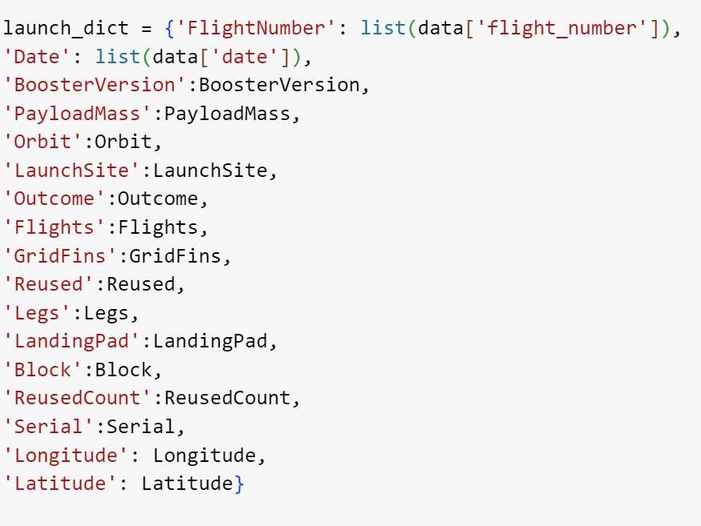
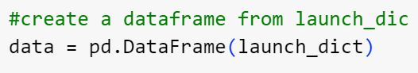
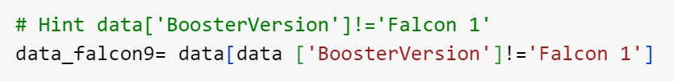
Data Collection – SpaceX API
1. Make a request to get rocket launch data
2. Normalize to data frame
3. Create a dictionary
4. Create a Pandas data frame
5. Filter Falcon 9 only
6. Save to CSV
3
8

Slide 9
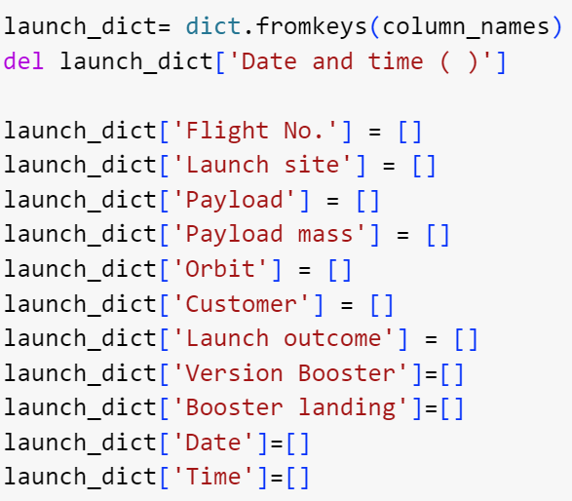
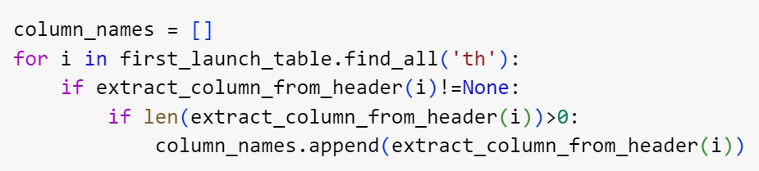
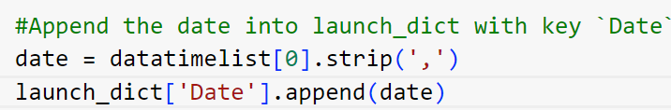
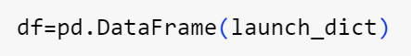
Data Collection – Scraping (Web Scraping from Wikipedia)
1. Get Response from HTML
5. Create a dictionary
2. Create Beautiful Soup Object
3. Find tables
4. Get column names
6. Append data to keys (e.g. below for Date- refer to notebook for more)
7. Convert dictionary to dataframe
8. Save to CSV
9

Slide 10
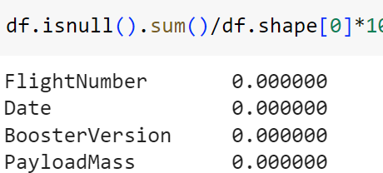
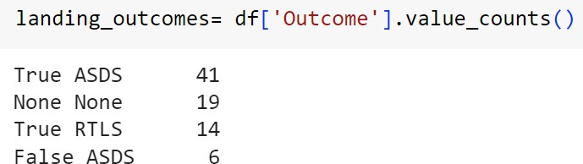
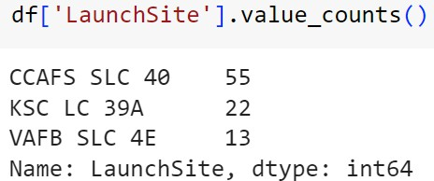
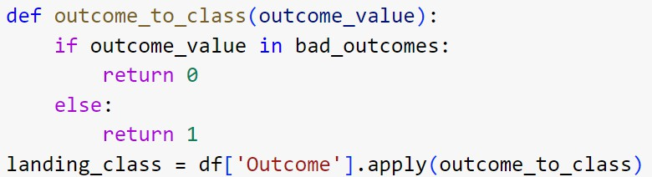
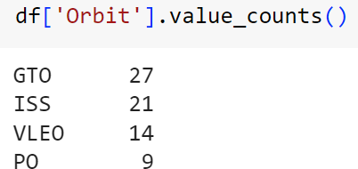
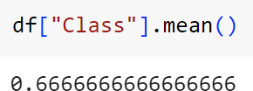
Data Wrangling
Initially some Exploratory Data Analysis (EDA) was performed:
Creation of Landing outcome label
EDA
Summarization
1. Check and calculate null values
4. Calculate the n and occurrence of outcome per orbit type
2. Calculate the n of launches on each site
5. Create a landing outcome label from Outcome column
3. Calculate the n and occurrence of each orbit
6. Calculate success from Class column
10

Slide 11
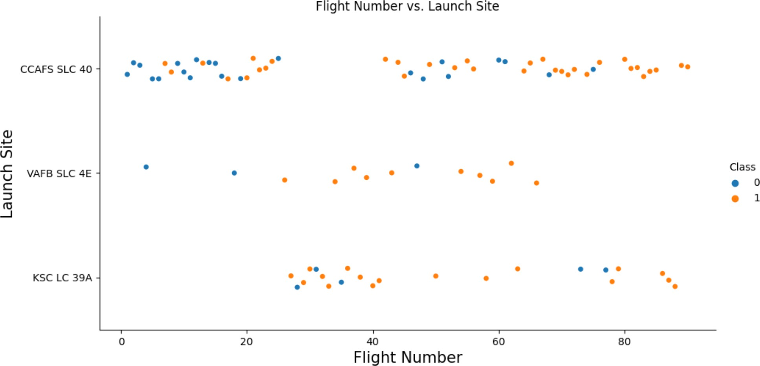
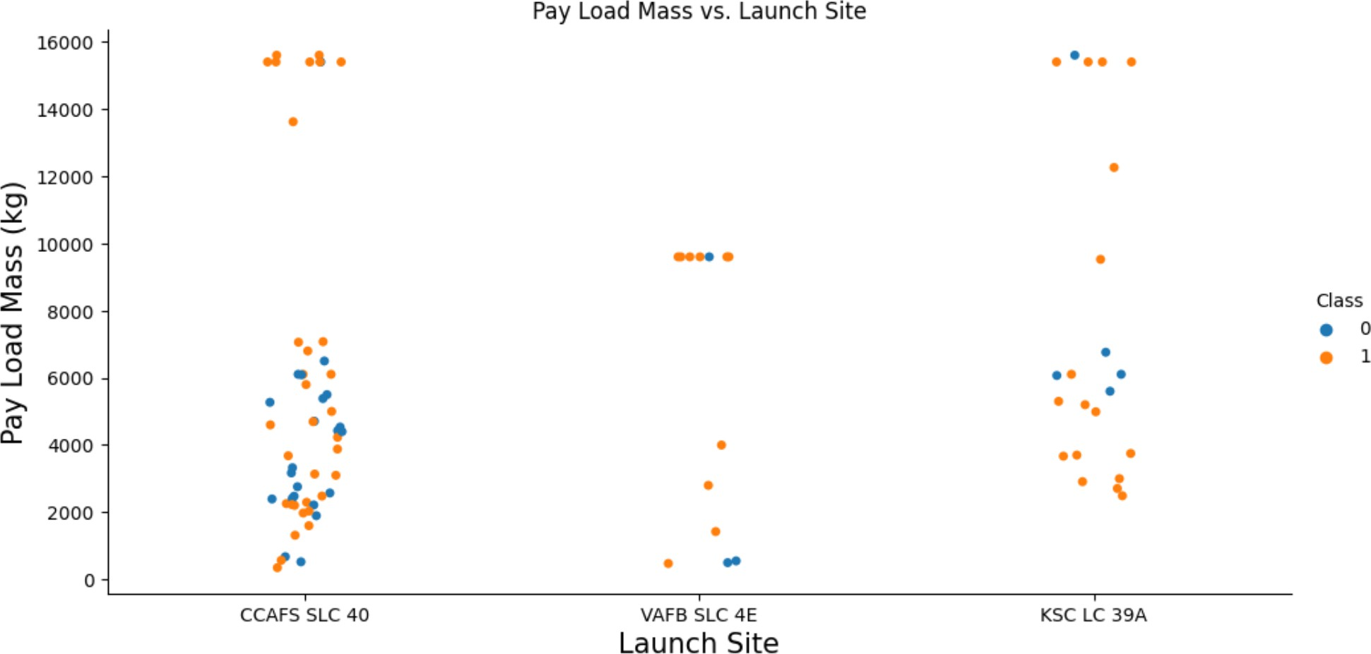
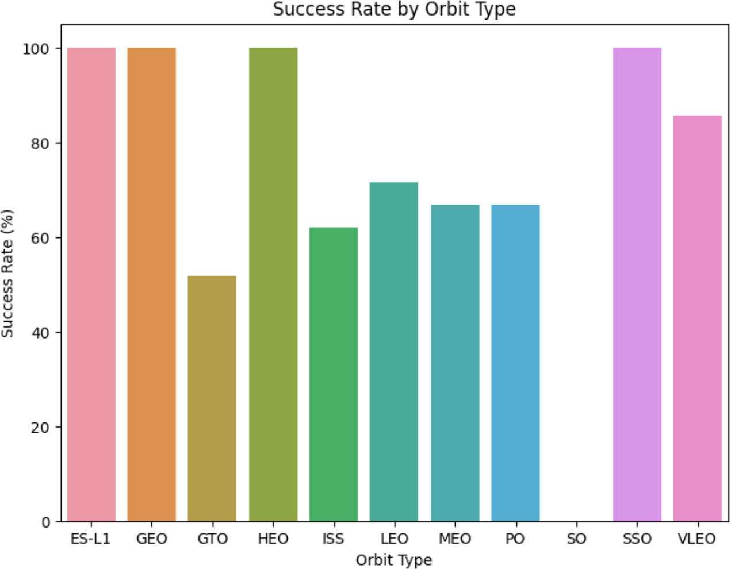
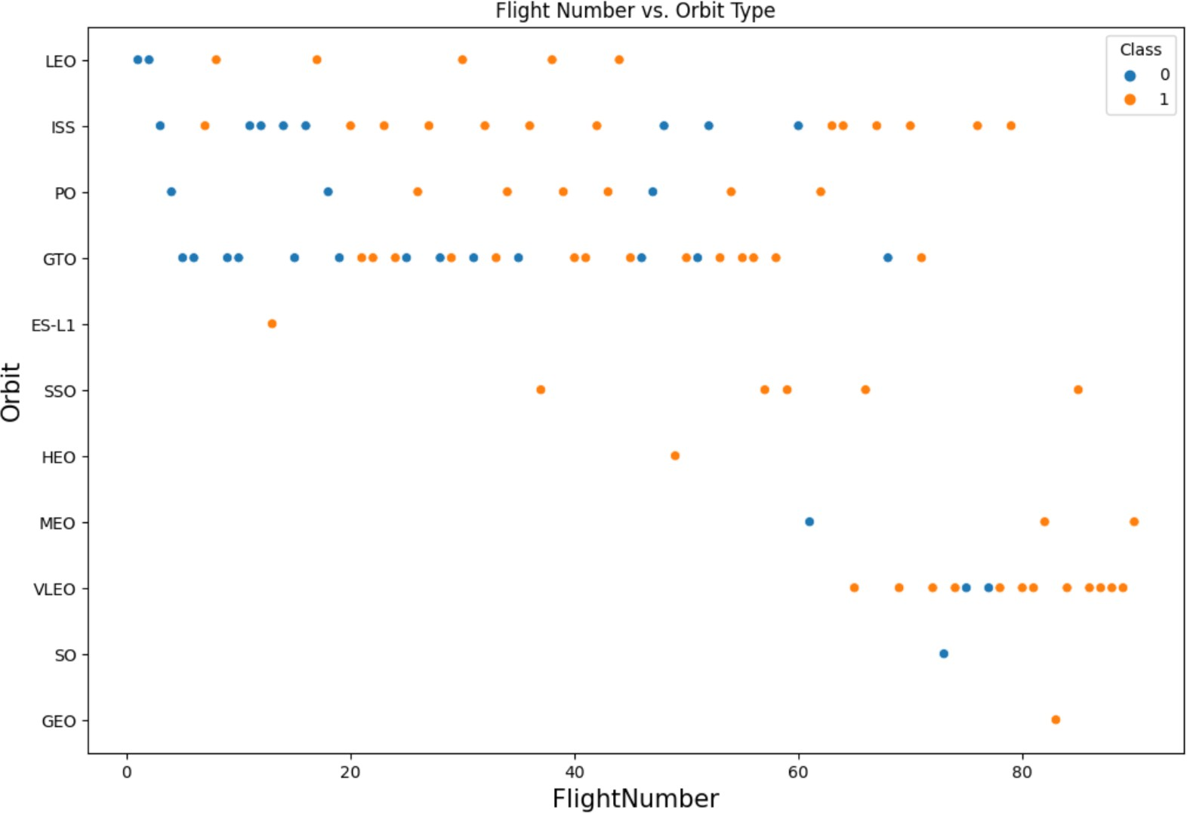
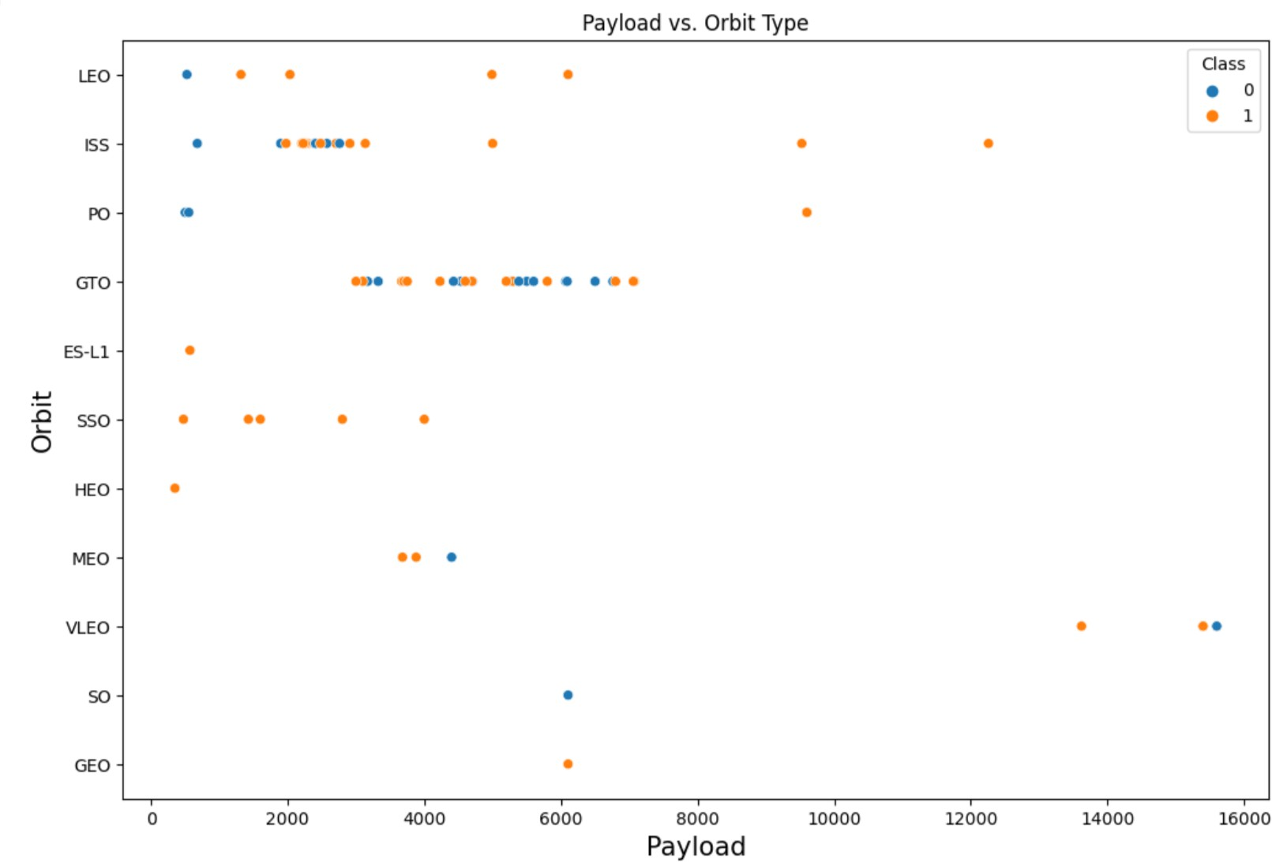
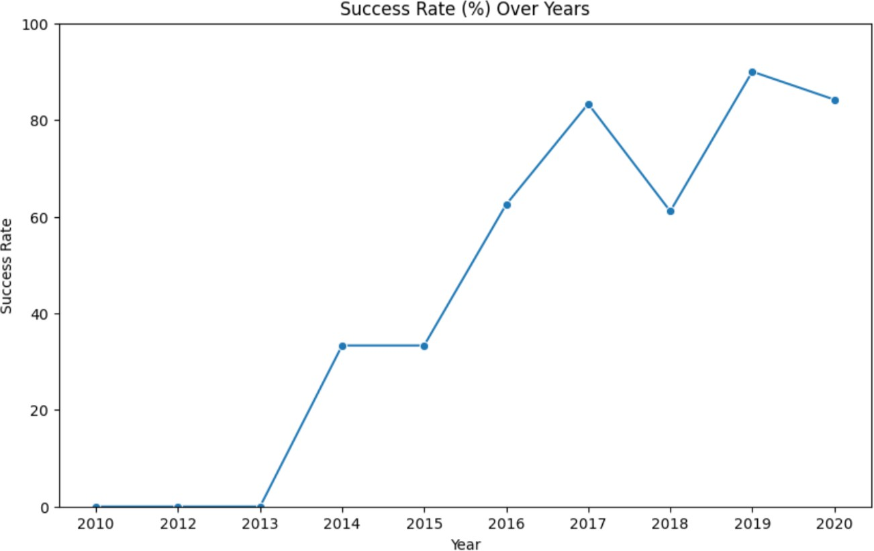
EDA with Data Visualization
To explore data, scatterplots, bar plots, were used to visualize the relationship between pair of features.
Flight Number and Launch Site
Payload Mass and Launch Site
Success Rate and Orbit Type
Flight Number and Orbit Type
Payload Mass and Orbit Type
Trend of success over the years
11
11

Slide 12
EDA with SQL
Displaying the names of the unique launch sites in the space mission
Displaying 5 records where launch sites begin with the string 'KSC
Displaying the total payload mass carried by boosters launched by NASA (CRS)
Displaying average payload mass carried by booster version F9 v1.1
Listing the date where the successful landing outcome in drone ship was achieved.
Listing the names of the boosters which have success in ground pad and have payload mass greater than 4000 but less than 6000
Listing the total number of successful and failure mission outcomes
Listing the names of the booster versions which have carried the maximum payload mass
Listing the records which will display the month names, successful landing outcomes in ground pad booster versions, launch site for the months in year 2017
Ranking the count of successful landing outcomes between the date 2010 06 04 and 2017 03 20 in descending order.

Slide 13
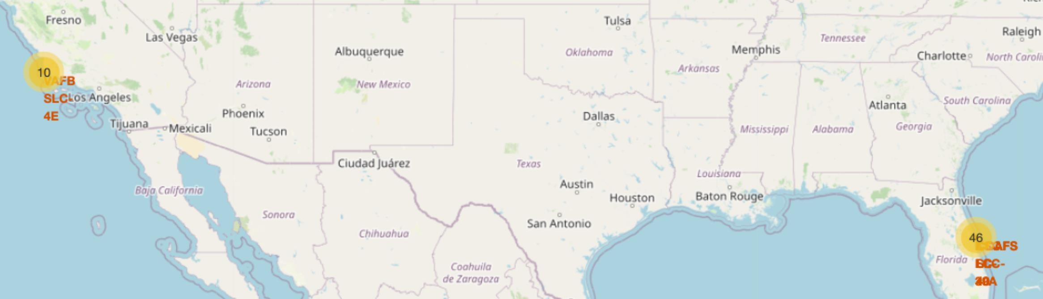
Build an Interactive Map with Folium
An interactive map offers a dynamic way to visualize and analyze launch site data, facilitating decision-making and insights into the spatial relationships of launch activities. For instance, the success rate may depend on the location and proximities of a launch site, i.e., the initial position of rocket trajectories.
We created three maps for:
Visualization of each launch site in an interactive map.
Visualization of launch sites on the map based on fail or success. This gives us insights into the performance of launch sites.
Visualization of the geographical context and proximity of the launch sites to railway, highway, coastline, etc

Slide 14
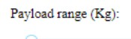
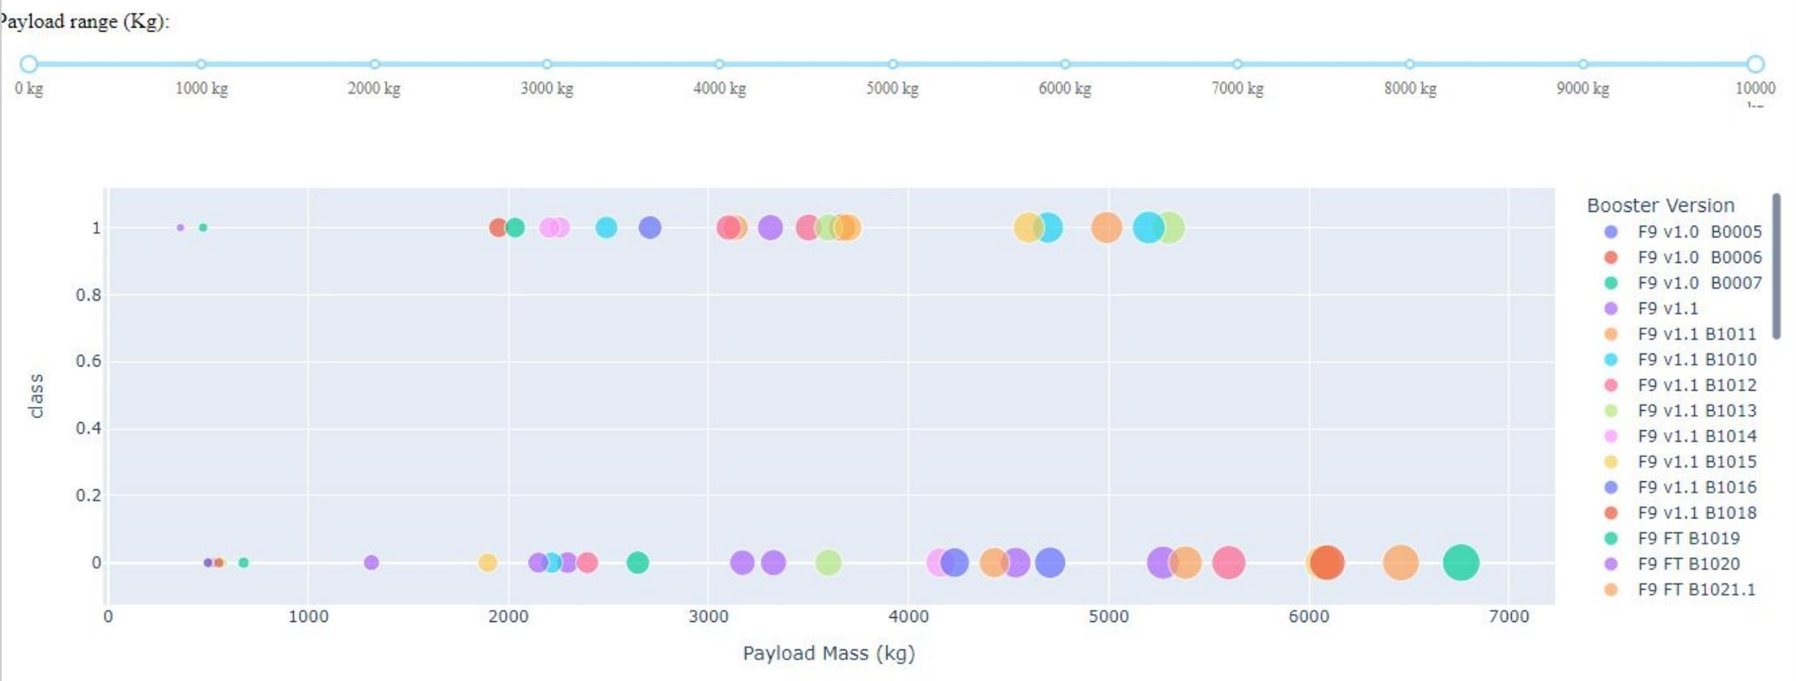
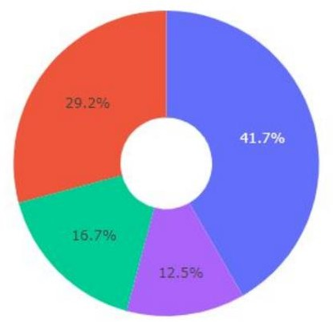
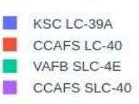
Build a Dashboard with Plotly Dash
Plotly Dash applications allows us to perform interactive visual analytics on SpaceX lunch data in real time.
We developed a dashboard that enables us to:
Visualize a pie chart depicting success based on the selected launch site.
Explore the correlation between success and payload by utilizing a Range Slider to choose the payload range, presented through a scatter plot.
14

Slide 15
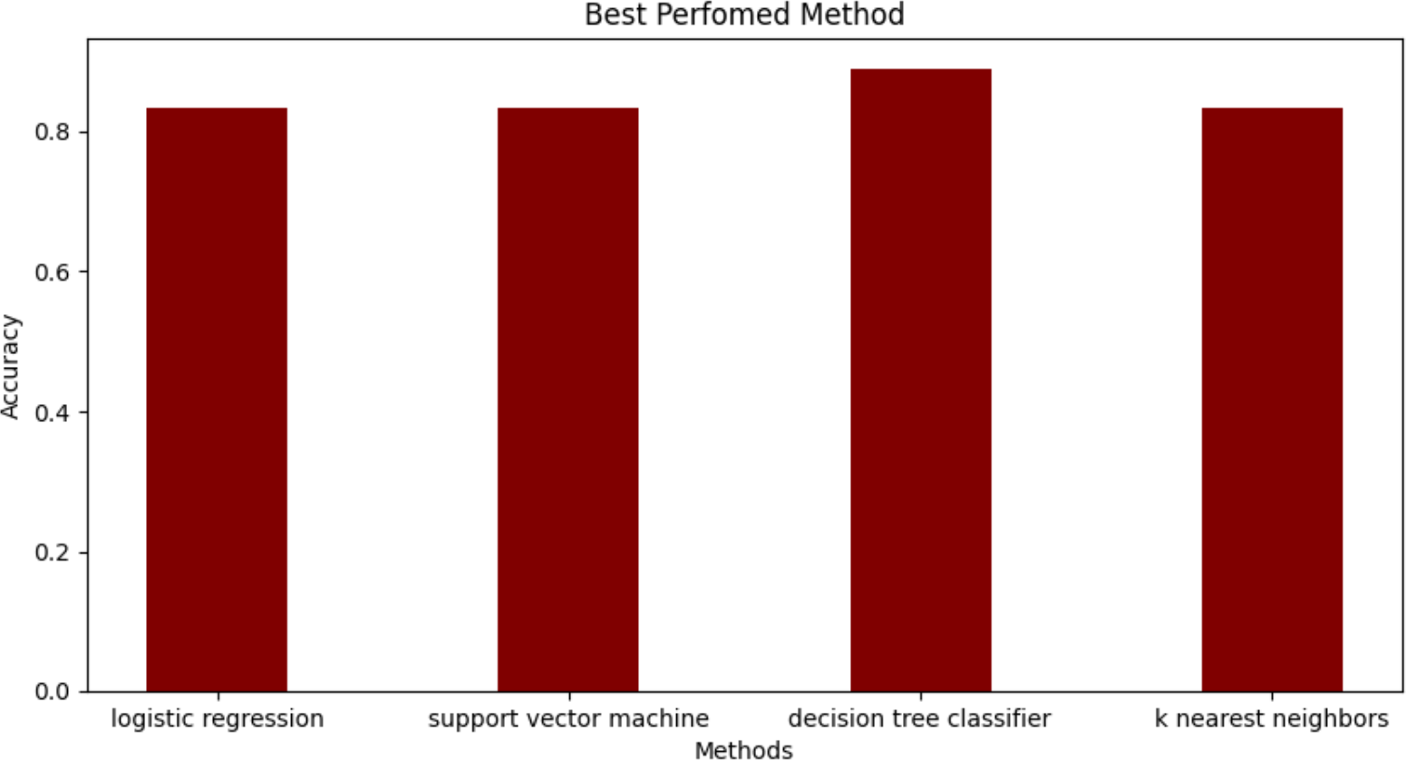
Predictive Analysis (Classification)
Four classification models including Linear Regression, K Nearest Neighbors, Decision Tree models, and Support Vector Machine, were built and compared.
Data preparation and
standardization
Test of each model with combinations of hyperparameters
Comparison of results

Slide 16
Results
The first successful ground pad landing took place on December 22, 2015.
The success rates for SpaceX launches increased over time (2013-2020).
The location of launch appears to be a significant contributing factor to the success of missions
KSC LC-39A has the most successful launches compared to other sites.
Low weighted payloads perform better than the heavier payloads.
ES-L1, GEO, HEO, and SSO orbits achieved the highest success rate.
For heavy payloads, the rates of success are higher for VLO and ISS orbits.
Decision Tree model is the best in terms of prediction accuracy for this dataset. For additional information, refer to slides 18 through 45.

Slide 17

Section 2

Slide 18
Flight Number vs. Launch Site
Most launches took off from CCAFS SLC 40 launch site
The initial launches were mostly carried out from the CCAFS SLC 40 launch site
•
The majority of recent launches from CCAFS SLC 40 resulted in success
18
•
The success rates for all launch sites improved over time.

Slide 19
Payload vs. Launch Site
VAFB SLC 4E launch site conducts launches with lower payloads (zero launches for >10000 kg)
CCAFS SLC 40 hosts a higher number of launches involving both higher and lower payloads.
•
Most payloads weighing over 9000 kg have achieved successful outcomes.
19

Slide 20
Success Rate vs. Orbit Type
ES-L1, GEO, HEO, and SSO orbits achieved the highest success rate at 100%, followed by VLEO with a success rate >80%, and LEO with a success rate >70%.

Slide 21
Flight Number vs. Orbit Type
In the recent years, there has been a transition towards launching missions into Very Low Earth Orbits (VLEO) with a significantly high rate of success.
While the GTO orbit experiences a low success rate, there appears to be no discernible relationship between flight number and the rate of success in this orbit.

Slide 22
Payload Mass vs. Orbit Type
For heavy payloads, the rates of success are higher for VLO and ISS orbits.
In the case of GTO, there seems no apparent relationship between payload
and the rate of success.

Slide 23
Launch Success Yearly Trend
The rate of success has seen a notable rise since 2013 and continued to rise until 2020, possibly attributed to technological advancements.
The first three years (2010-2013) seem to have been a phase focused on
fine-tuning and technological enhancement.
23

Slide 24
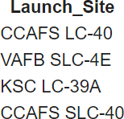
All Sites Names
Here are the names of four launch sites in the space mission:
The associated SQL code:

Slide 25
Launch Site Names Begin with 'CCA'
Five records where launch sites begin with the 'CCA’ are listed below:
The associated SQL code:

Slide 26
Total Payload Mass
The total payload carried by boosters from NASA (CRS) is 45596 (kg)
The associated SQL code:

Slide 27
Average Payload Mass by F9 v1.1
The average payload mass carried by booster version F9 v1.1 is 2928.4 (kg)
The associated SQL code:

Slide 28
First Successful Ground Landing Date
The first successful ground pad landing took place on December 22, 2015.
The associated SQL code:

Slide 29
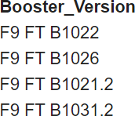
Successful Drone Ship Landing with Payload between 4000 and 6000
The boosters that have successfully landed on drone ships and carried payloads with a mass exceeding 4000 but below 6000
are as follows:
The associated SQL code:

Slide 30
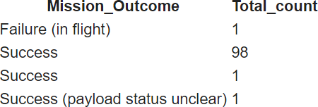
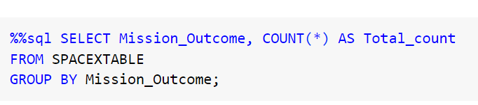
Total Number of Successful and Failure Mission Outcomes
The total number of 100 mission outcomes, including both successful and unsuccessful results is presented in the following breakdown:
The associated SQL code:

Slide 31
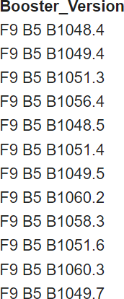
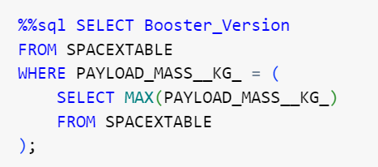
Boosters Carried Maximum Payload
The boosters which have carried the maximum payload mass include:
The associate SQL code:

Slide 32
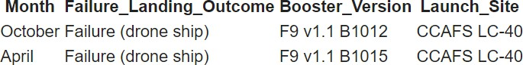
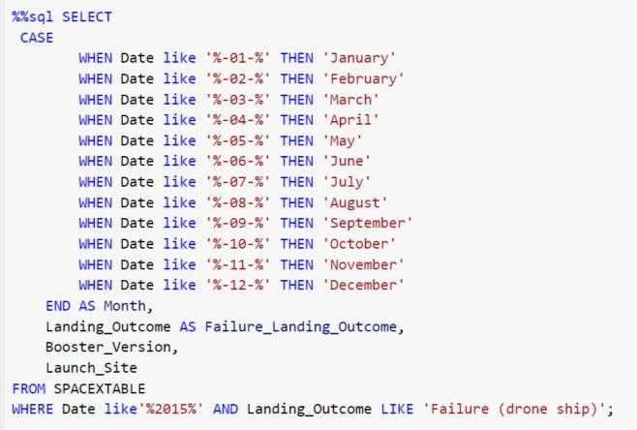
2015 Launch Records
The unsuccessful landing outcomes on drone ships, along with their corresponding booster versions and launch site names, during the year 2015, are provided below:
The associated SQL code:

Slide 33
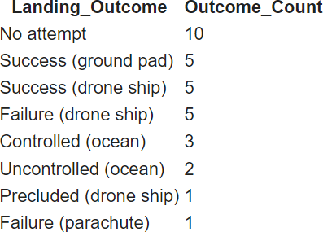
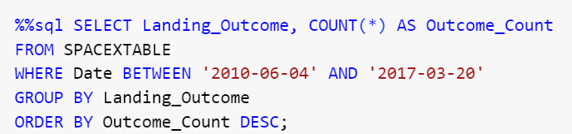
Rank Landing Outcomes Between 2010-06-04 and 2017-03-20
The tally of landing results (including Failure on drone ships or Success on ground pads) occurring between June 4, 2010, and March 20, 2017, is presented in a descending order:
As shown, the highest count among the landing outcomes is attributed to "No attempt", totaling 10. This is followed by "Success (ground pad) ", "Success (drone ship) ", and "Failure (drone ship) " each occurring 5 times, while "Controlled (ocean)" is observed 3 times.
The associated SQL code:

Slide 34

Section 3

Slide 35
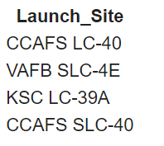
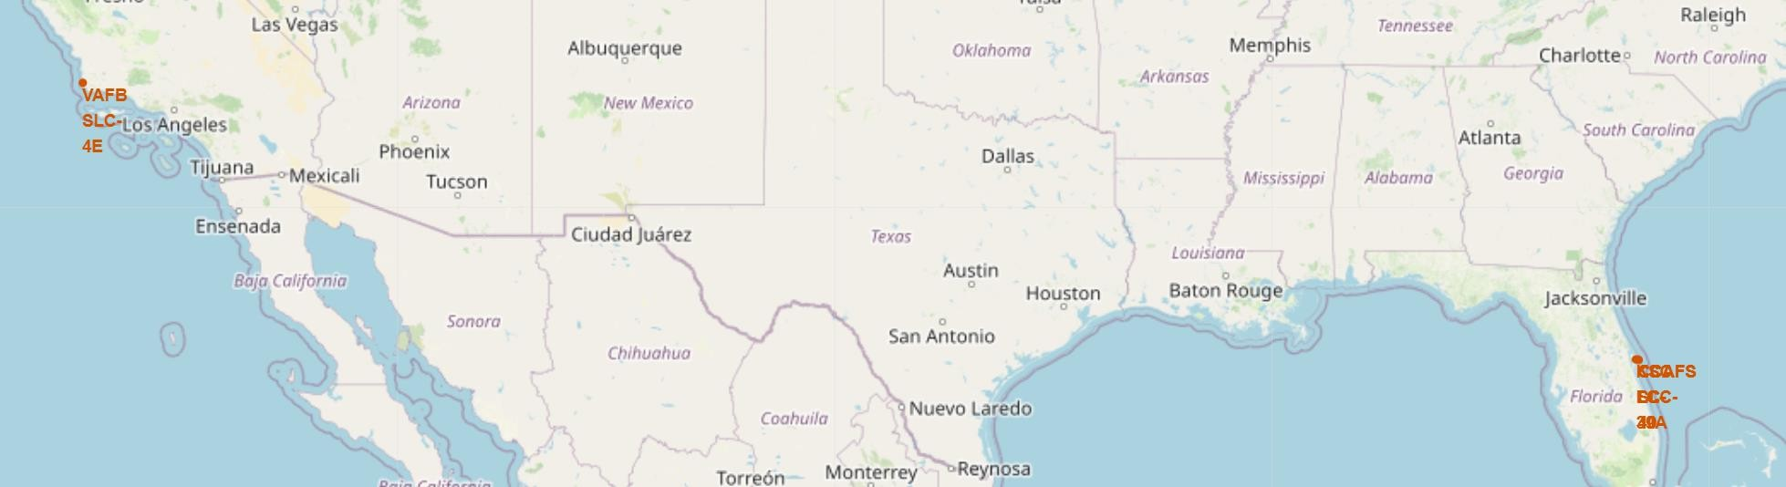

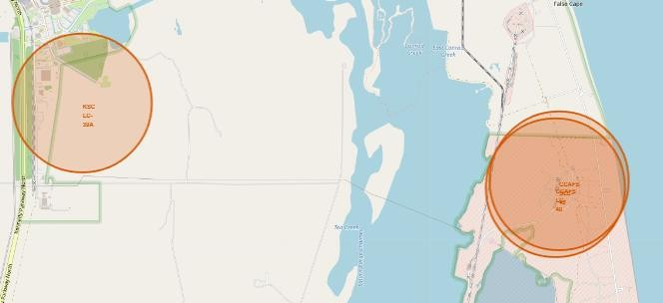
Folium Map Screenshot 1 – Launch Site Locations
VAFB SLC-4E is situated near the western coastline, while KSC LC-39A, CCAFLC-40, and CCAFSLC-40 are positioned along the eastern coastline.
Upon zooming in, it seems both CCAFLC-40 and CCAFSLC-40 are situated in very close proximity to each other.
35

Slide 36
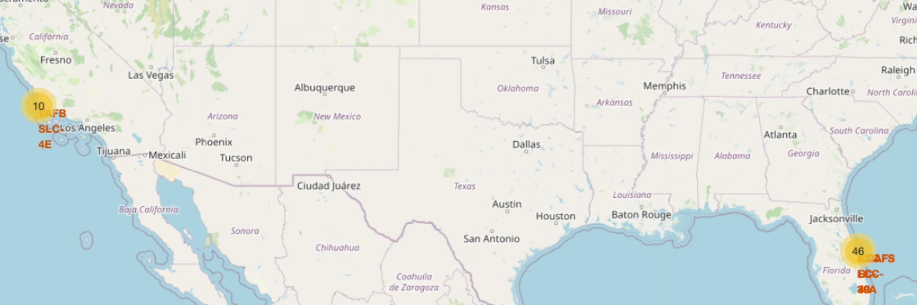
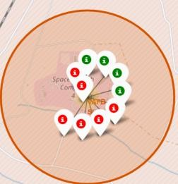
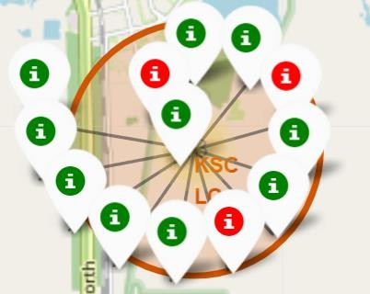
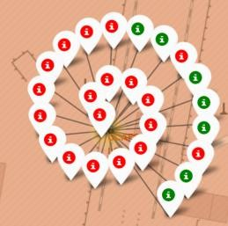
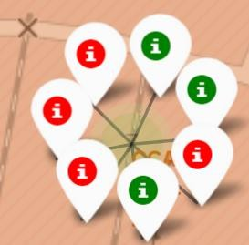
Folium Map Screenshot 2 – Success/Failed Launches for Launch Sites
VAFB SLC-4E
KSC LC-39A CCALC-40 CCAFLC-40
Upon zooming in, we can see the success (green) and failure (red) marks for each site.
Out of 13 launches, KSC LC-39A has achieved the highest success rate with 10 successful missions (10/13=76.9%)
36

Slide 37
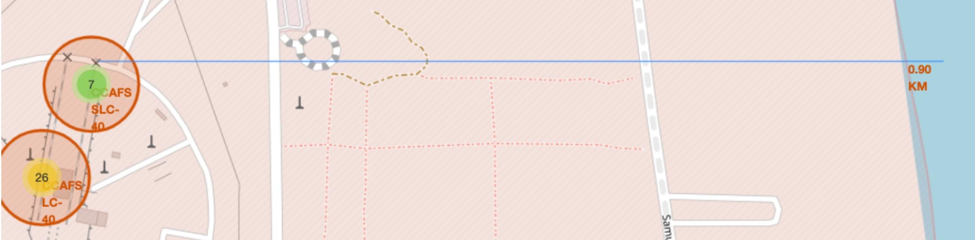

Folium Map Screenshot 3 – Proximity of Launch Sites to Other Areas
These figures show a PolyLine between CCAFSLC-40 to the selected coastline point, etc.
37

Slide 38

Section 4

Slide 39


Dashboard Screen Shot 1 – Total Success Launches By All Sites
The location of launch appears to be a significant contributing factor to the success of missions.
KSC LC-39A has the most successful launches compared to other sites.
39

Slide 40

Dashboard Screen Shot 2 – Launch Site With Highest Launch Success Ratio
Using the dropdown menu on the dashboard allows for viewing single site launches.
At KSC LC-39A, 76.9% of the launches resulted in success, while 23.1% experienced failure.

Slide 41


Dashboard Screen Shot 3 – Payload vs. Launch Outcome
With the Range Slider, we can observe the outcomes of both successful and failed launches for each booster version, along with the corresponding payload they carried.
Success rates are higher for lighter payloads compared to heavier ones.
Low Weighted Payload 0-4000kg Heavy Weighted Payload 4000-10000kg

Slide 42

Section 5

Slide 43
Classification Accuracy:
Decision Tree model achieved the highest accuracy at 88 %, while the SVM performs the best in terms of Area Under the Curve at 0.96 (not shown).

Slide 44



Confusion Matrix:
Logistic Regression (LR)
Support Vector Machine (SVM)
Decision Tree (DT)
K Nearest Neighbors (KNN)
All four models can distinguish between the different classes.
However, the major problem for LR, SVM, and KNN is False Positives (n=3)
Decision Tree has the least False Positive (n=1)

Slide 45
Conclusions:
The success rates for SpaceX launches increased over time (2013-2020).
KSC LC-39A has the most successful launches compared to other sites.
Low weighted payloads perform better than the heavier payloads.
ES-L1, GEO, HEO, and SSO orbits achieved the highest success rate.
For heavy payloads, the rates of success are higher for VLO and ISS orbits.
Decision Tree models are the best in terms of prediction accuracy for this dataset.
Through the utilization of available data and comprehensive analysis, rocket companies can pinpoint the most effective techniques for diminishing launch expenses. This approach averts the risk of losing clients and ensures they remain competitive in the market.

Slide 46


